Slide 1
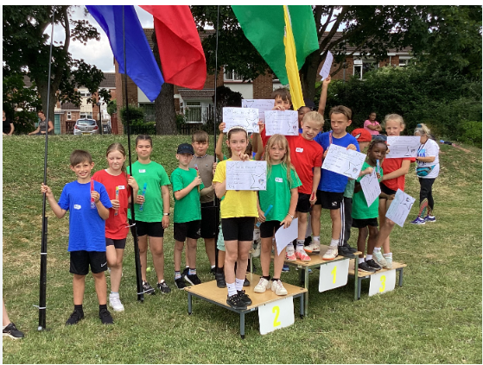


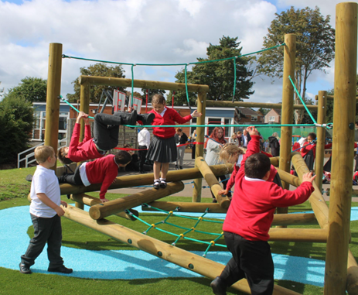
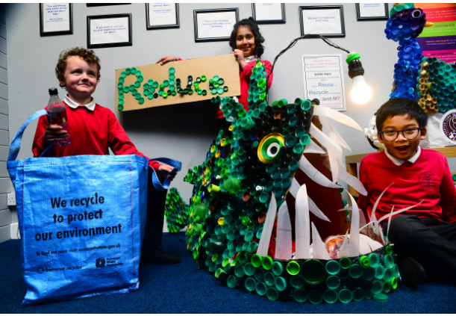
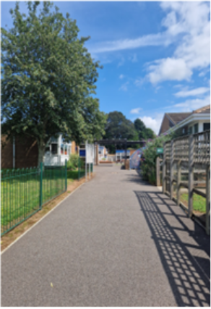
SEND Information Report
Date October 2025

Slide 2

This report is designed to inform you of the types of support available for your child at Lyngford Park Primary School and Nursery.
It will help you understand who can help and how this help can be accessed.
This report has been co-produced with staff, parents, carers, students and governors (Oct 2025)

Slide 3

Definition of Special Educational Needs
(taken from SEND Code of Practice: 0 to 25 years –
January 2015)
A pupil has SEN if they have a learning difficulty or disability which calls for special educational provision to be made for them. Namely provision that is different from or additional to that normally available to pupils of the same age. Making higher quality teaching normally available to the whole class is likely to mean that fewer pupils will require such support.

Slide 4
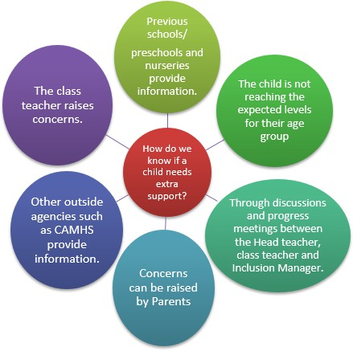
How does the school know if a child needs extra help?
All children at Lyngford Park Primary School and nursery are monitored closely by their class teachers and key workers. This is through regular observation and assessment.
Information can also come from previous settings, parents and/or external agencies. We use this information to identify and support children’s needs. Initially, it is the responsibility of the class teacher to ensure needs are being met within the classroom or nursery setting. If the class teacher or key worker feels the child still isn’t making the required progress, they will discuss this with you and then with the Special Education Needs and Disabilities Co-ordinator (SENDCo) if needed.
Assessments may be carried out and, if necessary, additional interventions may be put in place. A referral may be made to external agencies with your consent.

Slide 5
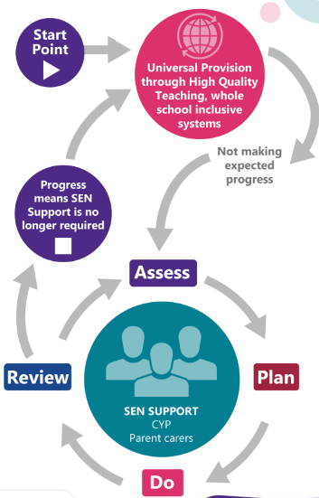
How will the school support my child?
The class teacher or key worker at nursery is responsible for your child’s education.
They will plan and provide more individualised work for your child if needed or adapt class tasks to enable your child to access the learning.
All teachers follow the same process for children who need some extra support which looks like this: look at image.

Slide 6

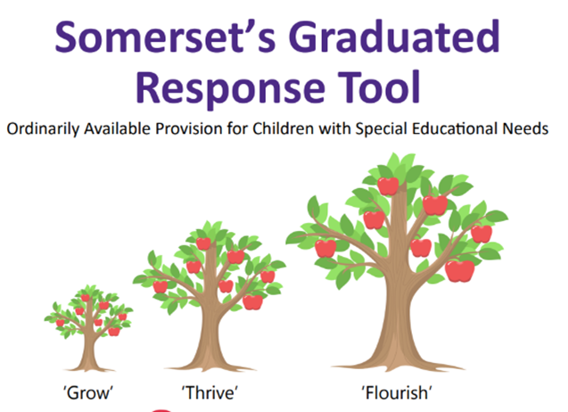
How will the school decide what level of support is needed?
The school uses the Somerset ‘Graduated Response’ to support identification of student’s needs or barriers to learning along with what support may be appropriate. Somerset’s Graduated Response Tool.
When a need or barrier to learning is identified, students will be supported initially through in class strategies and support. This is known as Universal Provision. This is overseen by the Class Teacher with input from the SENDCo. Your child may be added to our monitoring list at this stage.
Progress is then monitored through an ‘Assess, Plan, Do, Review’ (APDR) process that measures the impact of any intervention/strategy and plans appropriate future support.
If support which is additional to and different from their peers is required at this stage your child may be added to the SEN register.
If a child has complex/acute needs, their profile may sit within the school’s High Needs stage. This may mean that a student would benefit from an Education, Health and Care Plan (EHCP) to support their needs and identify specific provision.

Slide 7

What type of support may be provided for my child at each level of SEND support?
High Needs Support
This is available for the few highest needs children and may include: Specialist support from external professionals such as TDPC, Pediatrician or educational psychologist input, 1:1 LSA support needed to enable access to education, A high level of physical, communication or sensory support.
Universal Provision
This is available to all/most children and may include: Adaptations to tasks or activities, a range of recording methods, additional learning resources e.g. concrete maths equipment, word or vocabulary mats, seating plans, movement breaks, class visual timetables. Group interventions and class forest school sessions.
SEND Support
Targeted support at this level is available to some children. It may include: Individual learning plans, 1:1 academic or SEMH interventions, LSA support, individual timetables or planning, now & next, sensory, SALT or OT plans or advice needing a significant level of input or adaption. Referrals to external professionals may be made at this stage such as SALT, OT or Neurodevelopmental pathway.
Please note that if the Neurodevelopmental pathway is being considered/ completed for ADHD /ASC or has a diagnosis doesn’t automatically mean your child will be on the SEN register or an EHCP should be applied for. It is around needs and provision based on the Graduated Response.

Slide 8
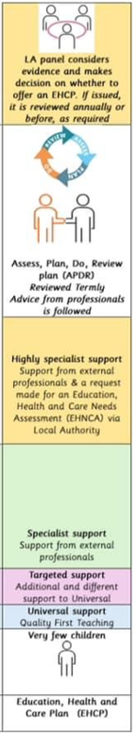
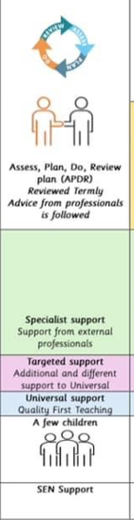
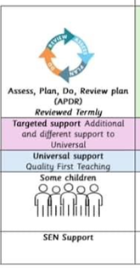
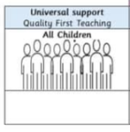
Please note: if your child has a diagnosis, this doesn’t automatically mean your child will be on the SEN register or an EHCP should be applied for. For some children with a diagnosis, the universal provision provided to the whole class is sufficient to meet their needs.
SEND
Graduated
Response

Slide 9

Who will coordinate the provision for my child?
Our SENDCOs coordinate the support and progress of any child on our SEN support list. You should know if your child is on this list and it simply means that Helen Ingram our SENDCo is overseeing their learning. Any additional provision/support that your child is receiving will be explained to you at parent’s evening.
Helen Ingram
School and Nursery SENDCO

Slide 10
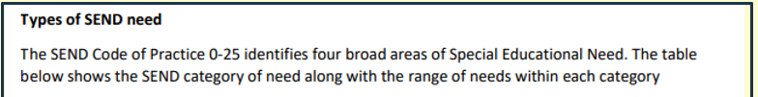
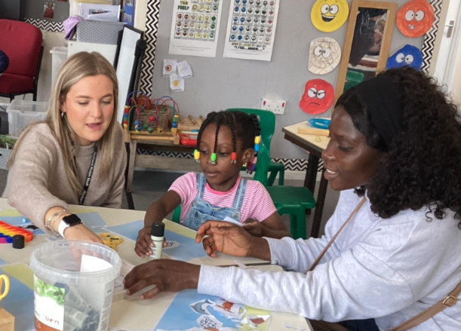
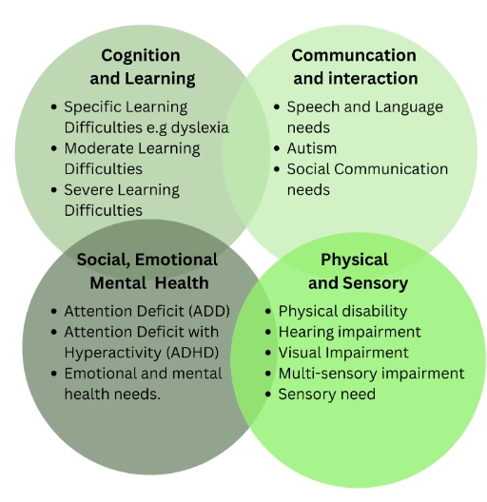
What kinds of SEND are provided for at Lyngford Park?

Slide 11
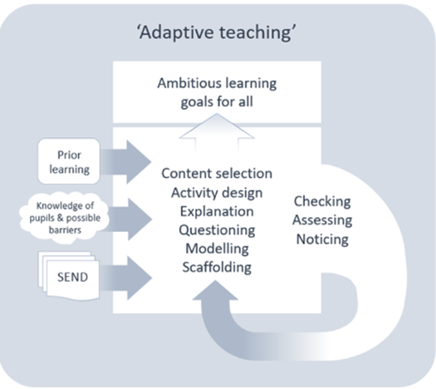
How will the school’s approach be adapted to match my child’s needs?
As a school we are committed to providing high quality teaching. Most children will follow the same curriculum as their peers, with teachers altering the lesson content to take account of learning needs. Observation, marking and assessment inform teachers’ planning to ensure all work is accurately pitched at an appropriate level.
Specific resources and strategies will be used to support your child individually and/or in groups.
Where appropriate we will offer an adapted behaviour plan (Pastoral support plan) for your child in line with professional advice.
Reasonable adjustments can be made to support your child.

Slide 12

How will I know how my child is doing?
Individual progress for any child can be affected by many factors, which is why a graduated response is used. At Lyngford Park we track each student’s progress from the baseline information we collect on entry to the school. All staff are therefore aware of the expected rates of achievement for each individual.
The school uses termly assessments to track each child’s progress. Additional provision is also tracked and monitored for impact.
There are parents’ meetings in the Autumn and Spring terms for children who have SEND provision. End of year reports are sent home in the Summer term. Any child with complex needs or in receipt of an Education, Health and Care plans (somerset.gov.uk) will also have an Annual Review meeting to inform and plan for next steps. These meetings will provide you with the opportunity to discuss your child’s pupil passport, the support they have had that term and their progress.
‘Progress’ does, of course, include success in non-academic areas such as life skills, social and emotional development, etc and this is equally monitored and targeted.
In addition to the school’s usual reporting process, students with SEND may also have:
Interim progress meetings
Pupil Support Plan reviews
Meetings with outside agencies
Specific meetings with other relevant members of staff
In addition, every child receiving SEND provision will also have a Pupil passport. Most will also have an individual learning plan (ILP) that is a cycle of APDR (Assess, Plan, Do Review). These will be written and shared with you at times of review at the end of each term. At parent meetings these can be discussed. Parent comments on the ILP’s are always encouraged and welcomed.

Slide 13




What support will there be for my
child’s overall Mental Health and wellbeing?
Lyngford Park school is committed to the Mental Health and wellbeing of your child.
Your first point of contact is your child’s class teacher.
There are a variety of school clubs available to support your child’s social and personal development. Our PSHE curriculum is taught weekly and provides children with opportunities to discuss and identify how to look after and develop their own Mental Health and wellbeing.
THRIVE, little spots of emotions and relational approaches are used to support across the school in all classes. The THRIVE practitioner and ELSA work with children on an individual basis to support them with any social, emotional, mental health needs.
Kim Barratt
THRIVE Lead Practitioner, DSL and Pastoral lead

Slide 14
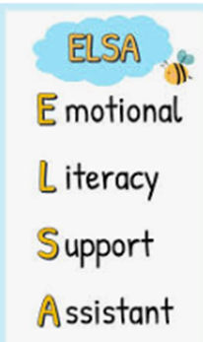
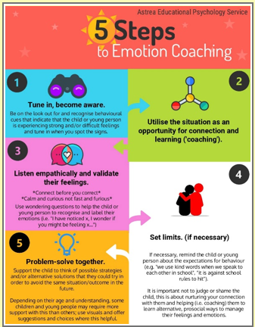
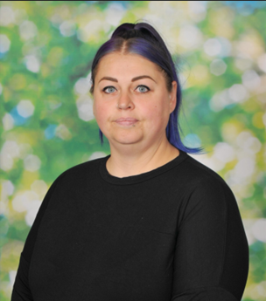
Emotional Literacy Support Assistant (ELSA)
An Emotional Literacy Support Assistant (ELSA) is a trained, school-based learning support assistant. Their role is to support the emotional wellbeing of pupils. They are trained by educational psychologists and receive ongoing group supervision.
Who do ELSAs work with?
ELSAs work with children either individually or in small groups and deliver bespoke interventions tailored to the situation or needs of the child/ren. The role of the ELSA is to develop children and young people’s:
Emotional literacy
Positive mental health
Social skills
Emotional well-being
ELSA’s receive training and supervision to support children needing support in the following areas:
Emotional literacy including building resilience and self-esteem
Managing emotions including anger and anxiety
Social and friendship skills
Loss, bereavement and family break up
Our ELSA is Mrs Houghton

Slide 15


Mental Health Support in Schools Team
What are the Mental Health Support Teams (MHSTs)?
The Mental Health Support Teams (MHSTs) in Somerset are a partnership between Young Somerset and Somerset CAMHS (Child and Adolescent Mental Health Services).
The MHST work in educational settings across the county, supporting children and young people aged 5-16 with their mental health and wellbeing. MHST’s primary goal is to ensure that children, young people and their families receive timely help when they need it. Additionally, they aim to build resilience by equipping children, young people and their families with tools and strategies to use now and in the future.
MHST provide support for mild to moderate mental health concerns through Low Intensity-Cognitive Behavioural Therapy (LI-CBT). MHST will discuss LI-CBT is most effective when mental health changes first begin to emerge. Support for younger children is normally provided through parent lead CBT enable them to support their children. For older children MHST may choose to work directly with students.
Referrals can be made via the Mental Health Leads termly consultation meetings with MHST.
Referrals will then be triaged by the MHST team and if the referral is successful children will be added to the waiting list.

Slide 16

What specialist services are available to support my child?
The staff team, has experience supporting children with dyslexia, autistic spectrum condition, ADHD, social and emotional difficulties, speech and language difficulties, general learning difficulties and physical/sensory needs.
When needed we can seek advice from services such as:
Children and Young People’s Therapy Service (including Speech & Language Therapists,
Occupational Therapists, etc)
Local Authority Advisory Teachers from virtual schools
Taunton Deane Partnership College (TDPC) - outreach service for SEMH needs (Social, Emotional and Mental Health)
Child and Adolescent Mental Health Service (CAMHS)
Education Safeguarding Service (ESS)
Mental Health support team (MHST)
Young Somerset

Slide 17

What support does Lyngford Park have for a parents including parents of children with SEND?
Your child’s class teacher and SENDCo will be happy to offer any support they can, following the School’s Graduated Response. Mrs Barratt, the Pastoral Lead and DSL is also available.
We can also signpost and/or refer you to other specialist support services…
Home (somersetsend.org.uk) SENDIAS
Somerset’s SEND Local Offer The SEND Local Offer
Family Intervention Service (somerset.gov.uk) FIS
Somerset Parent Carer Forum CIC Ltd (not for profit) company no. 10227489- Somerset Parent/Carer forum

Slide 18

Is there anyone else who might work with my child?
A range of outside professionals may be consulted to provide support or advice to help us to meet your child’s needs.
For further information on the services available, please look at the Somerset Local Offer website:
Somerset’s SEND Local Offer

Slide 19
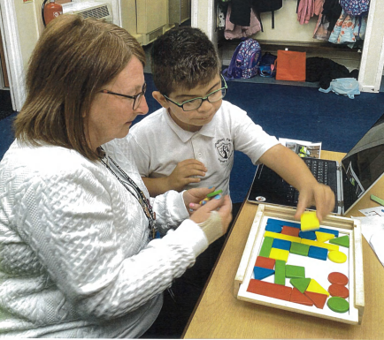
What training is made available to staff supporting children with SEND?
All staff have regular training opportunities to support the children at Lyngford Park including those with SEND. The focus of training is regularly reviewed according to the needs of the children and the school’s priorities for improvement.
All adults who work with individuals or groups of children receive the necessary support or training to deliver the sessions. These sessions are overseen by the class teacher and the SENDCo to monitor the progress of the children. The extent and level of training/support provided depends on the nature of a child’s needs and the provision needed.
Pic of staff/children

Slide 20
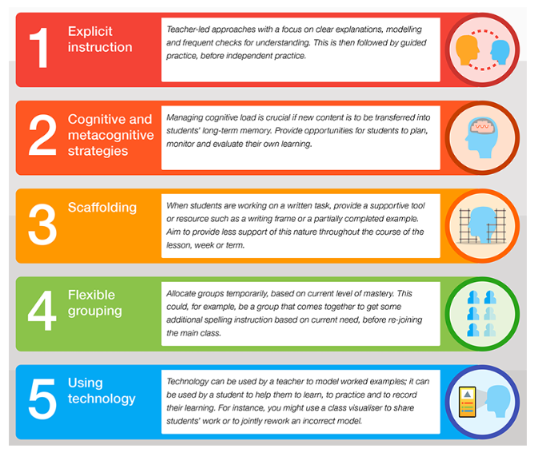
How are resources allocated and matched to my child’s needs?
We ensure that all children who have additional needs are supported to the best of the school’s ability with the funds available.
We firmly believe at Lyngford Park that all teachers are teachers of all the children in their class. Where possible additional provision will be delivered by the teacher through differentiated/adapted learning opportunities within the classroom. We also have a team of Learning Support Assistants (LSAs) who are in part funded from the SEN budget and support both individual and small groups of children, alongside the class teachers.
Some children also need specialist equipment and/or facilities. A small number of children are eligible for top up funding which the school can use to provide additional support/resources within the child’s setting.

Slide 21
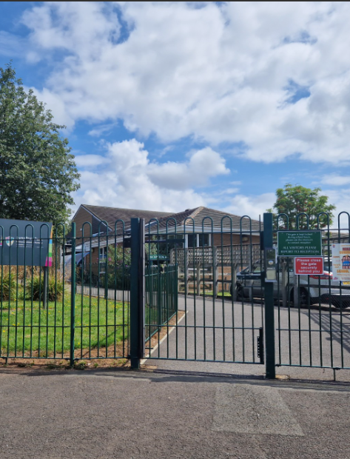

How accessible is the school environment?
The school site is wheelchair accessible and there are changing facilities and accessible toilets. All children have the right to access class wherever it is safe for them to do so. For those children with additional needs, alternative provision can be made, for example, additional adult support, alternative travel arrangements, or alternative arrangements for the administration of medicines. For further information on accessibility please see our separate Accessibility Plan.

Slide 22
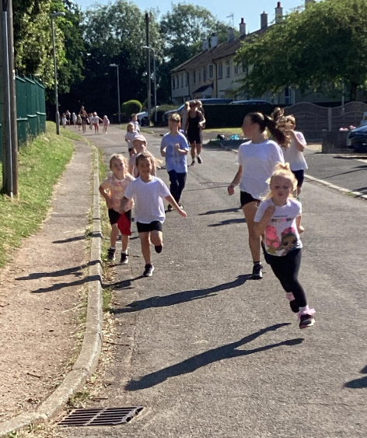

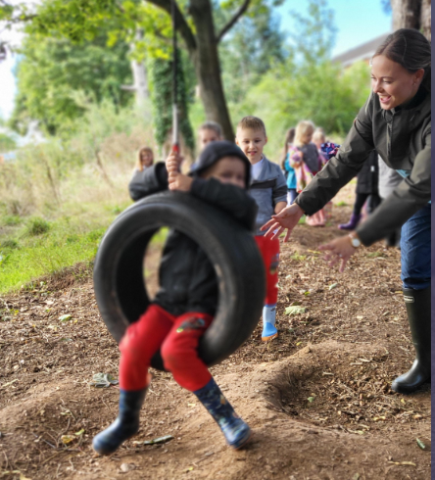
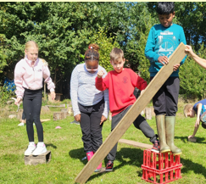
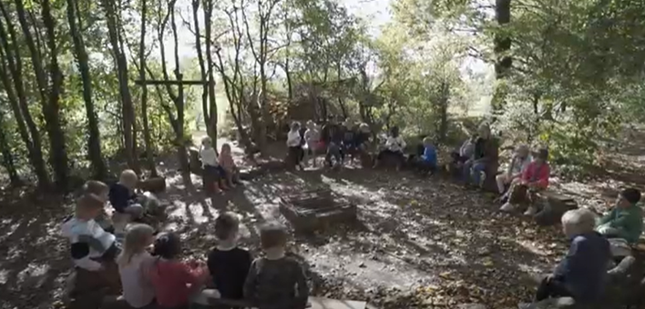
How will my child be included in activities outside of the classroom?
Students with SEND are supported and encouraged to be fully involved in all aspects of school life. Individual arrangements (and risk assessments if necessary) are planned in advance to ensure they can be appropriately included on trips, offsite activities and extra-curricular events.
For those students unable to participate in the usual curriculum’s sporting or outdoor activities appropriate adaptions have been made to ensure that appropriate challenge and participation is inclusive for all children.

Slide 23


How will my child and I be involved in decision making and planning for their education?
For parents/carers
Parent meetings with class teachers and SENDCo if appropriate
Home visits - reception pupils only as part of transition
Phone calls home
Open door policy
EHCP annual reviews
For children:
Pupil voice
1:1 conversations
Through getting to know your child- we take the holistic approach

Slide 24

How will the school support my child’s transition to a new setting?
Prior to starting in Reception, children identified as having SEND will have a School Entry Planning meeting. This will be attended by parent/carers, pre-school staff, school staff and any external professionals involved in supporting your child. An action plan is devised to make the transition to school as smooth as possible. Lyngford Park staff, will also visit pre-schools to meet the children in a familiar setting. All children will be invited to attend settling-in sessions to ensure they are familiar with the staff and the setting in advance. Home visits are carried out in the Autumn term by our Reception class teachers and teaching assistants.
When moving to Secondary School, children with additional needs are discussed with the SENDCo at the secondary School once places have been allocated. Additional visits can be organised by the secondary school. If your child has complex needs and has an Education Health Care Plan, an Annual Review meeting will take place in the Summer term of Year 5 or the Autumn term of Year 6 to ensure the Local Authority has the information needed to update the child’s Education Health Care Plan and consult with possible secondary schools.

Slide 25

Who should I contact for more information or if I am concerned about my child?
Speak to your child’s teacher in the first instance.
If you are still concerned, you can make an appointment to meet the SENDCo, Helen Ingram.
If you feel you need further support, please make an appointment with the Headteacher to discuss your concerns.
If you still have concerns, you may contact our Chair of Governors via the school office.

Slide 26
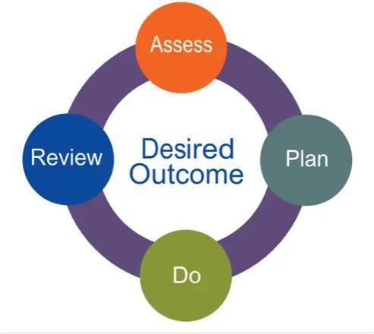
How will the school advise me if they have concerns about my child?
If we have concerns about any aspect of your child’s school life, the most appropriate member of staff will contact you. This may be your child’s class teacher or a member of the school’s Senior Leadership Team.
Staff may also use other opportunities such as your child’s school report, Individual Learning Plans (ILP’s), Pupil Passport or parents evening to let you know about any concerns.
In line with the SEND Code of Practice, we will always inform parents/carers if special educational provision is being put in place for your child and they are being placed on the school’s SEND register.

Slide 27


What are people’s views on inclusion at our school?
Chair of Governors- reflection on report and provision
The inclusion of parent and pupil perspectives demonstrates co-production and reinforces confidence in the school’s inclusive ethos. The glossary of terms is a valuable addition, ensuring clarity for parents.
Visually, the PowerPoint is easy to follow, with information presented in an accessible way. It balances statutory detail with practical support, reassuring families about the provision in place.
It reflects the school’s commitment to inclusion and provides a transparent, parent-friendly overview of SEND support.
We are very inclusive and have had good training to achieve this” Class Teacher.
“I believe our inclusion is high and we are very good at adapting to meet all our children's needs” Class Teacher.
“There is lots on offer for all children” Parent at the school
“I can’t thank the staff enough for the support given to my child and help them be happy in school” Parent at the school
“Lyngford park have always been so supportive to us as a family and helping with my child’s needs. Would always recommend them” Parent at the school
“We include everyone, respectful and kind” KS2 pupils

Slide 28






Useful resources for parents…
click on the images.

Slide 29
Who has contributed to this report?
Signed on behalf of the senior leadership team:
Nick Arnold (Head teacher)
Helen Ingram (SENDCo)
This report was presented to and approved by the school’s Senior Leadership Team in September 2025
Signed on behalf of the Governing Body:
Faye Forsyth (Chair of the Governing Body)
Nic Saint (SEND Governor)
This report was presented to and approved by the school’s Governing Body

Slide 30
Who has contributed to this report?
A big thank you to the children, Parents/ Carers, external professionals, Governors and staff who consulted on this report.

Slide 31
Glossary of terms
Occupational Therapy (OT) An NHS service which supports children who have difficulties with everyday physical tasks, such as handwriting, balance or coordination.
Personalised Learning Plan (PLP) A document which describes strengths and needs of children on the SEND register, as well as detailing their short-term targets and strategies which support them.
SALT (Speech and Language Therapy) An NHS service who support children with speech, language and communication difficulties.
SEMH (Social, Emotional and Mental Health) One of the 4 categories of SEND which describes children experiencing difficulties their mental health, emotions and/or behaviour.
SEN/SEND – Special Educational Needs/Special Educational Needs and Disabilities
SENDCo/SENCo (Special Educational Needs and Disabilities Coordinator) The teacher responsible for coordinating SEND support within a school
SEND Code of Practice The statutory guidance that schools and local authorities much follow in identifying and supporting children with SEND
SEND Register An internal school record which records the learning differences or disabilities of the children who require support in school which is additional to or different from their peers.
SEN/SEND Support The level of support provided for pupils with SEND who do not have an EHCP but who require additional help and support to meet their needs.
Sensory Processing Difficulties A term used to describe a child who struggles to interpret or respond appropriately to sensory information from more than one sensory system e.g. vision, hearing, touch, smell, taste
TAC/TAF (Team Around the Child/Family) A multi-agency approach to support a child and family’s needs involving both the family and outside agencies
ADHD(Attention Deficit Hyperactivity Disorder) A condition which can affect concentration, impulse control and activity levels.
ASC/ASC (Autism Spectrum Condition/Disorder) A neurodevelopmental condition that affects communication, social interaction and flexibility of thought.
Annual Review A yearly meeting to review the progress and needs of a pupil with an EHCP (see below), and to consider whether any changes are needed.
CAMHS (Child and Adolescent Mental Health Services) NHS services supporting children and young people with emotional, behavioural or mental health difficulties
Differentiation/Adaption Adapting teaching methods, tasks or resources to suit the individual needs of learners
EHCP (Education, Health and Care Plan) A legal document for children with significant and complex needs which sets out the support a child requires across education, health and social care.
EHCNA (Education, Health and Care Needs Assessment) The formal assessment process carried out by the local authority to determine whether a child or young person requires an EHCP.
EAL (English as an Additional Language) A term used to identify pupils for whom English is not the first language.
EPPLAC (Education and Personal Progress Plan for Looked After Children)
Graduated Response (APDR) A four-part cycle (Assess, Plan, Do, Review) used by schools to provide increasingly targeted support for children with SEND
Inclusion Ensuring all children, regardless of ability or need, are welcomed, valued and supported to fully take part in school life.
Intervention A specific programme of additional support, usually time limited, designed to help a child progress in a particular area

